Slide 1
WELCOME!
TEAM 6
Notes:
No slide master

Slide 2




TEAM 6
Project name : CampaignOptiSales -
Measure marketing campaign performance to optimize future strategies and enhance product placement for increased sales
Mohammed,
Abdul Haseeb
Md Irteza Chowdhury
Tacco-Melendez,
John
Abdelsalam, Mohamed
Project Lead
Business Analyst
Data Analyst
Data stewards

Slide 3
Roles & Responsibilities
Data Source Search
Problem Statement definition
Everyone
Everyone
Data Preparation
Data Visualization
Mohammed & John
Irteza & Mohammed
Data Storytelling
Data Documentation
John & Mohammed
Everyone

Slide 4
Project objectives.
Objective: Measure campaign performance to optimize future Campaign strategies and enhance product placement for increased sales.​
Enhancing product placement unlocks additional source of revenue.

Slide 5

Problem Statement
Optimize marketing strategies by measuring performance of previous marketing campaigns with various customer segmentation.
Conduct Market basket Analysis to find association of products unlocking additional revenue streams.

Slide 6
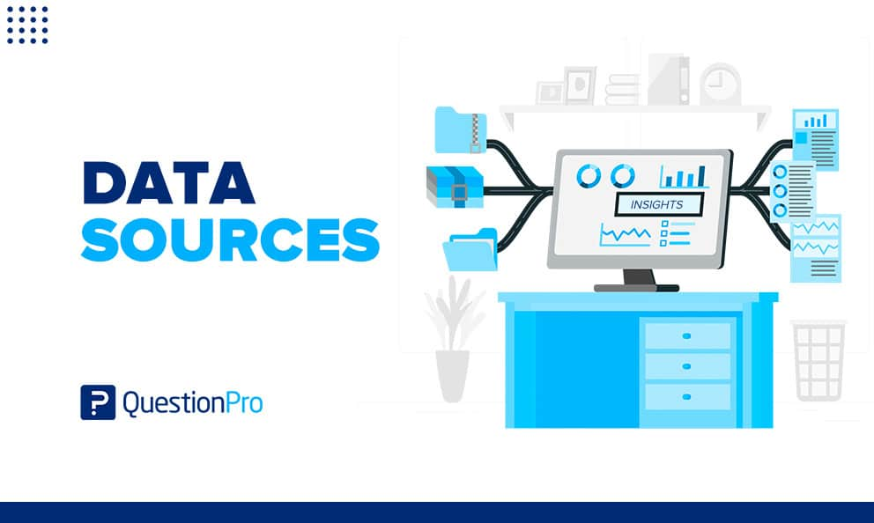
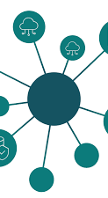
The Marketing Campaign data has been taken from Kaggle
The origin of the dataset is from SAS Institute
https://www.kaggle.com/datasets/rodsaldanha/arketing-campaign/data

Slide 7
Data Collection
The collection methodology used by SAS Institute is
“Business Analytics Using SAS Enterprise Guide and SAS Enterprise Miner”.

Slide 8
Data Cleaning & Preparation
Exploring the dataset
Convert columns to appropriate types
Check for duplicates
Check for missing values - Income
Drop columns not necessary for analysis – Z_CostContact, Z_Revenue
Check distributions, correlations of columns
Check columns for outliers

Slide 9
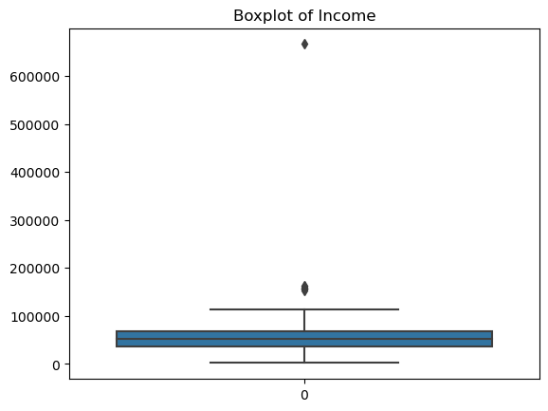
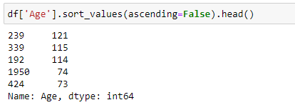
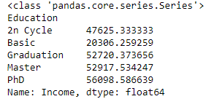
Data Cleaning

Slide 10
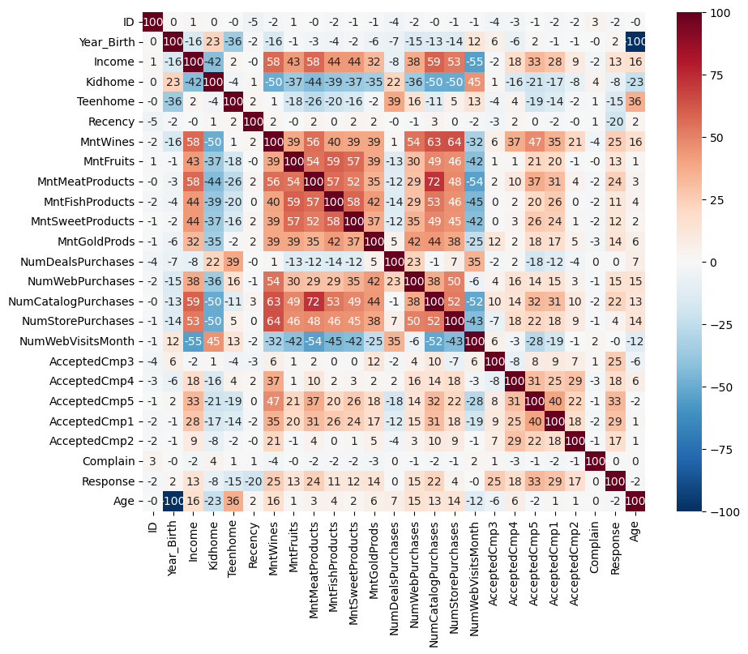
Correlations

Slide 11
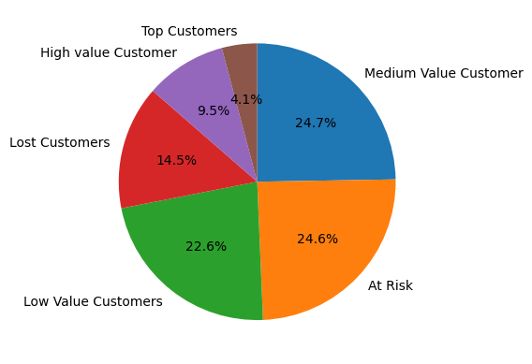

Tools and technologies used for data visualization “
Matplotlib and Seaborn libraries.
Power BI

Slide 12
Data Modelling
For Market Basket Analysis we have used Apriori algorithm
For customer segmentation we have used k-means algorithm

Slide 13
Reasons for Choosing Apriori
1
Association rule mining
4
Cross-Product Effect
Apriori is specifically designed for association rule mining, which is the primary task in market basket analysis
Apriori algorithm shows probability of a product being purchases by independently and how its probability is affected by by placing it with another product
2
Apriori Principle
5
Interpretability
The Apriori principle, which states that if an itemset is infrequent, then its supersets are also infrequent
The rules of Apriori algorithm are easy to interpret, support, confidence and lift
3
Widely Adopted
6
Customization
Apriori is a widely adopted and well-established algorithm for market basket analysis
Apriori algorithm allows us to set the minimum support to filter out infrequent associations

Slide 14
Reasons for Choosing K-Means
1
Simplicity
4
Flexibility
K-Means is simple to understand and implement
K-Means can handle different data types
2
Scalability
5
Applicability
K-means is computationally effective
K-Means is widely used for customer segmentation across industries
3
Interpretability
6
Iterative Improvement
Clusters produced by K-Means are easy to interpret.
Centroids serve as mean of each cluster
Adjusting number of clusters, we can improve segmentation

Slide 15

Aggregated nature of dataset for Apriori Algorithm

Slide 16
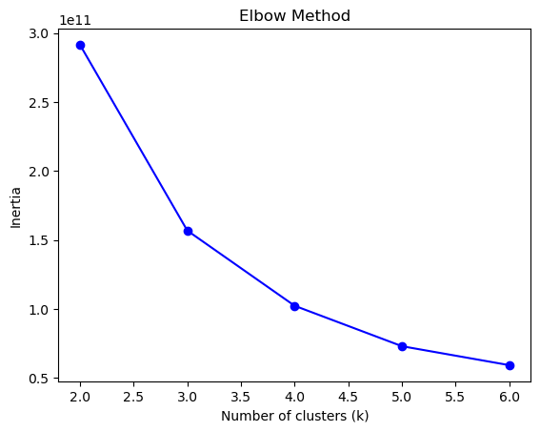
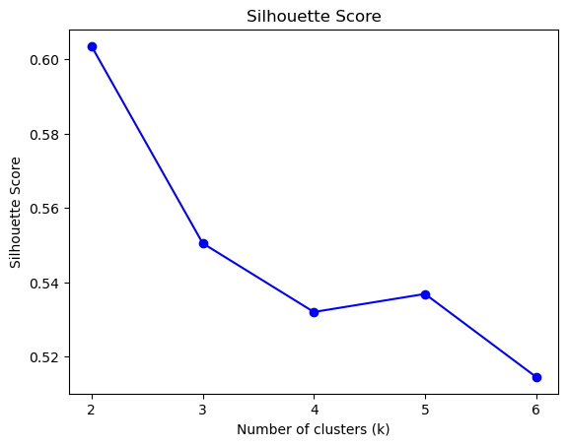
Finding optimal number of clusters for age by income

Slide 17
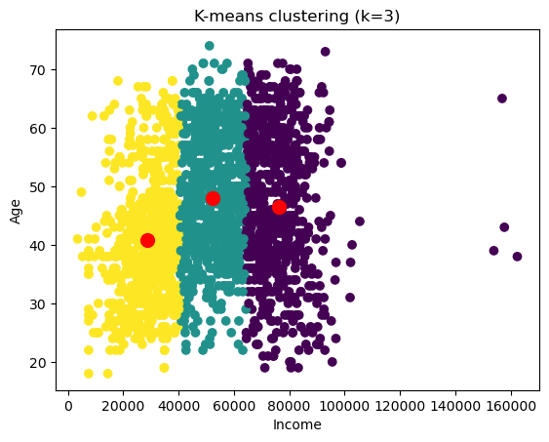
Age by Income k-means clusters
Clusters produced by K-Means are easy to interpret.
Centroids serve as mean of each cluster

Slide 18
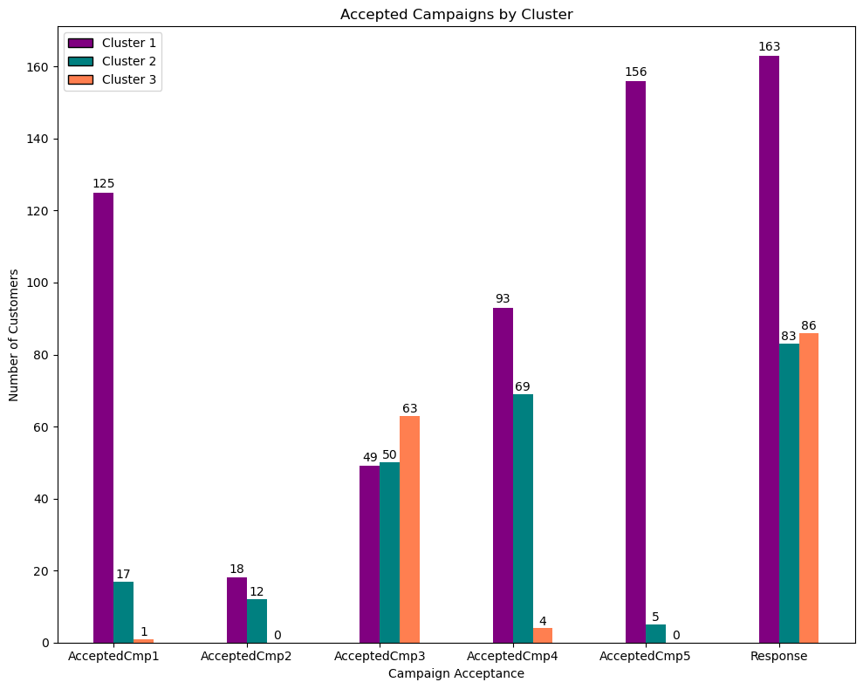
Accepted Campaign by Clusters for Age by Income
Performance of marketing campaign for the three clusters created using k-means for age by income.

Slide 19

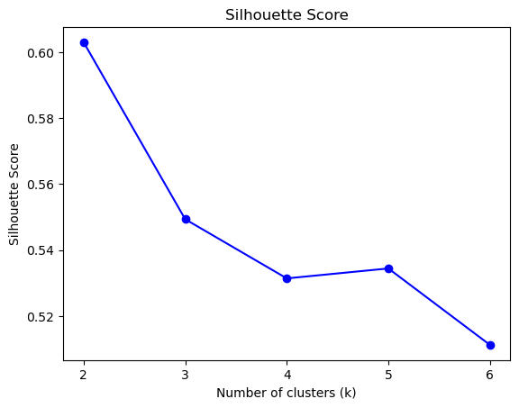
Finding optimal number of clusters for income by Monetary

Slide 20
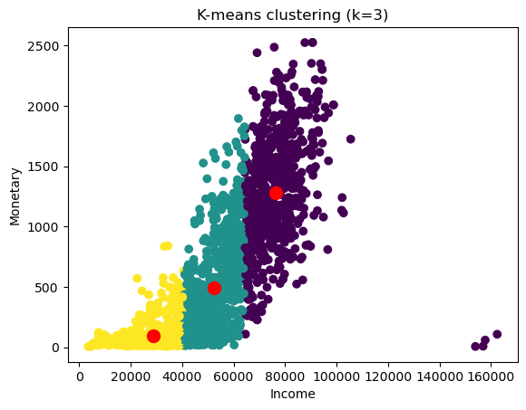
Income by Monetary k-means clusters
Clusters produced by K-Means are easy to interpret.
Centroids serve as mean of each cluster

Slide 21

Accepted Campaign by Clusters for Income by Monetary
Performance of marketing campaign for the three clusters created using k-means for age by income.

Slide 22
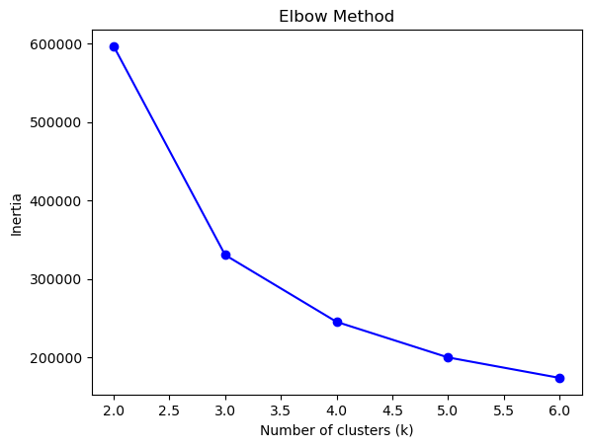
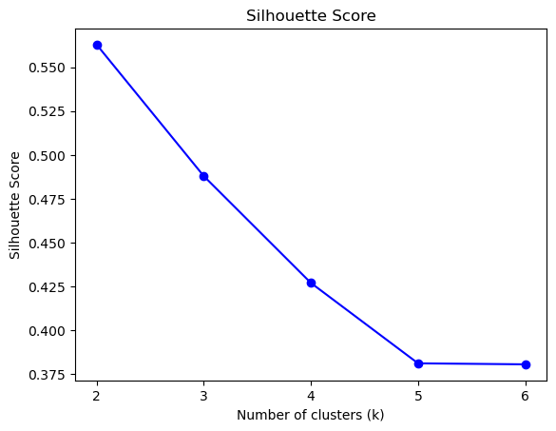
Finding optimal number of clusters for Recency by Frequency

Slide 23
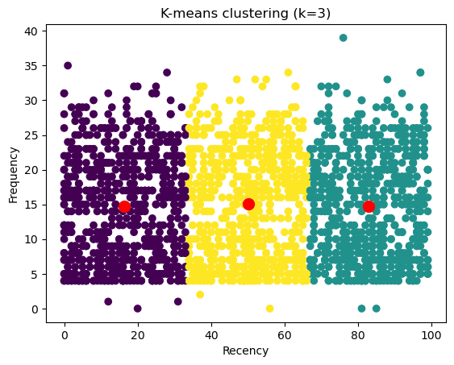
Recency by Frequency k-means clusters
Clusters produced by K-Means are easy to interpret.
Centroids serve as mean of each cluster

Slide 24
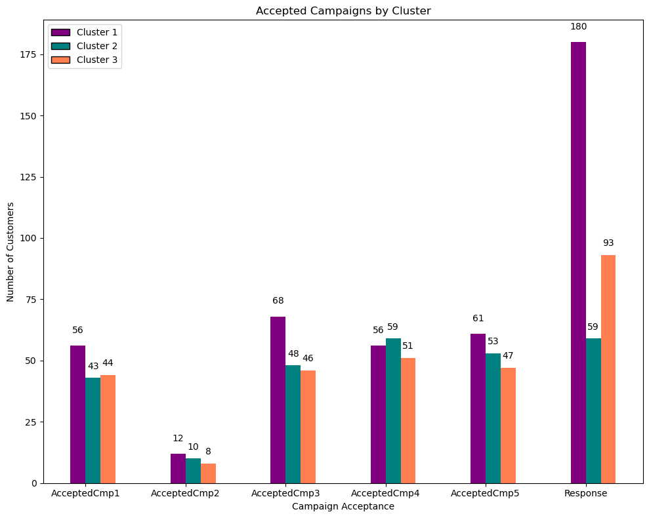
Accepted Campaign by Clusters for Recency by Frequency
Performance of marketing campaign for the three clusters created using k-means for Recency by Frequency.

Slide 25
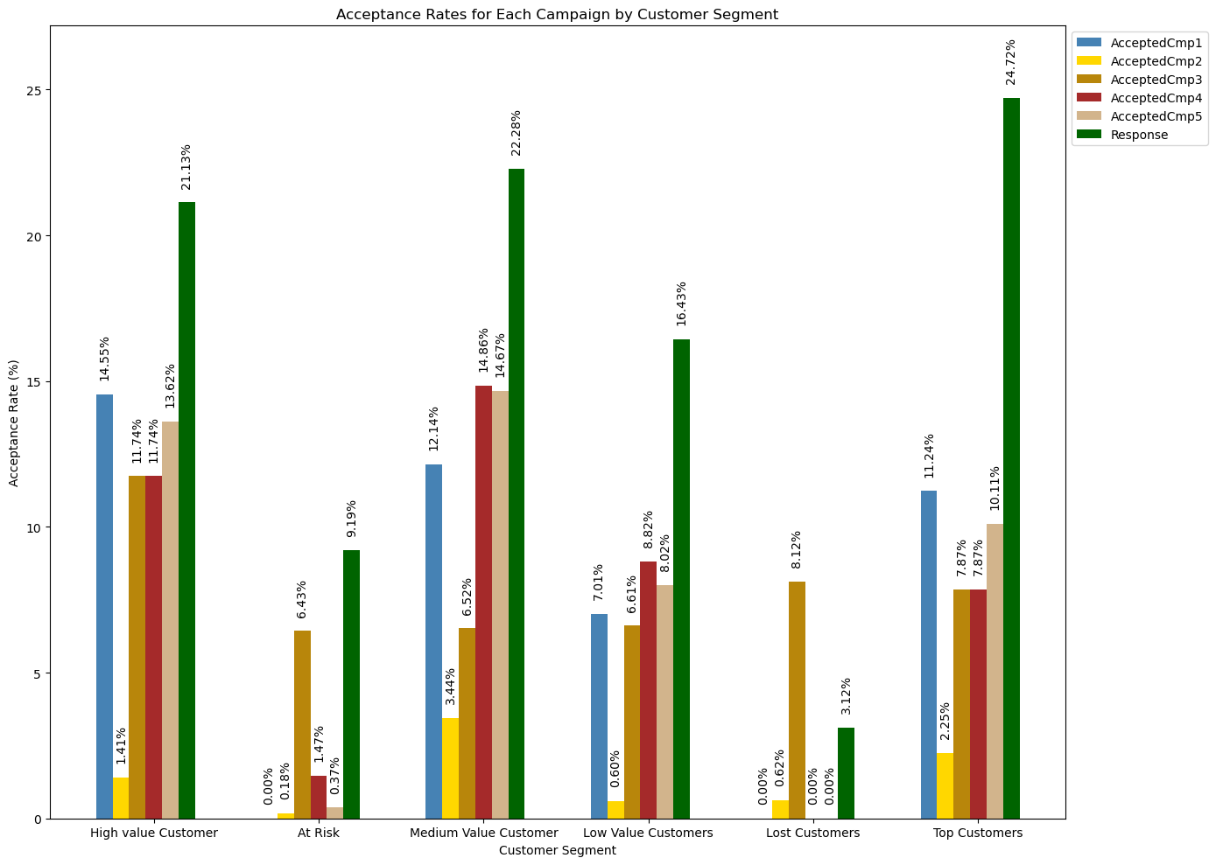
Assessing Campaign Performance
Recency
Frequency
Monitory

Slide 26
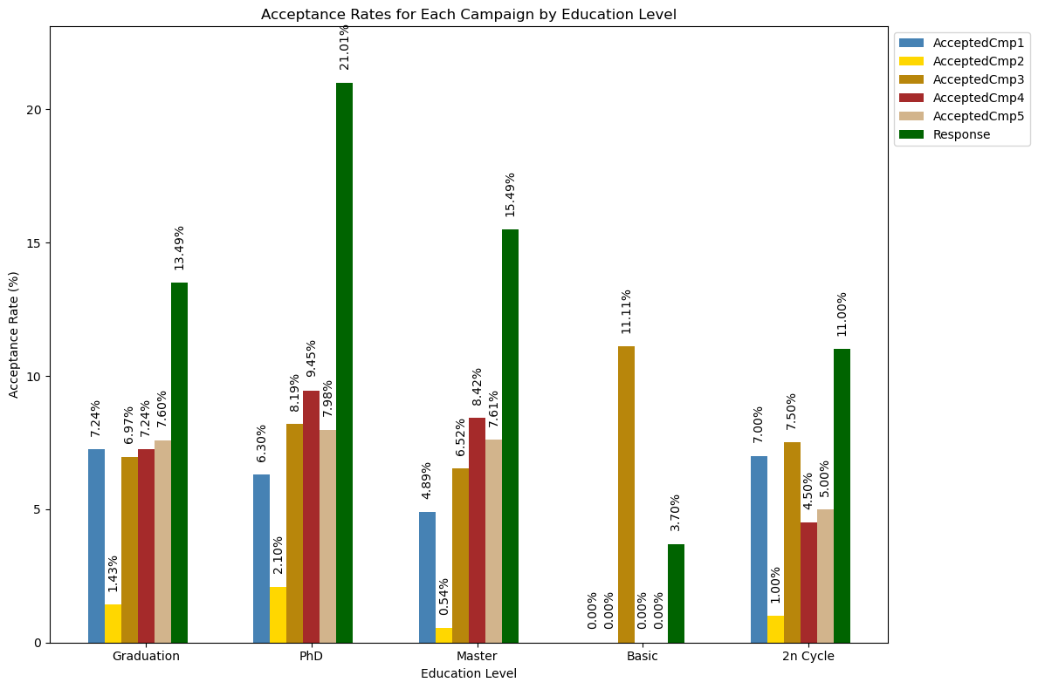
Assessing Campaign Performance

Slide 27
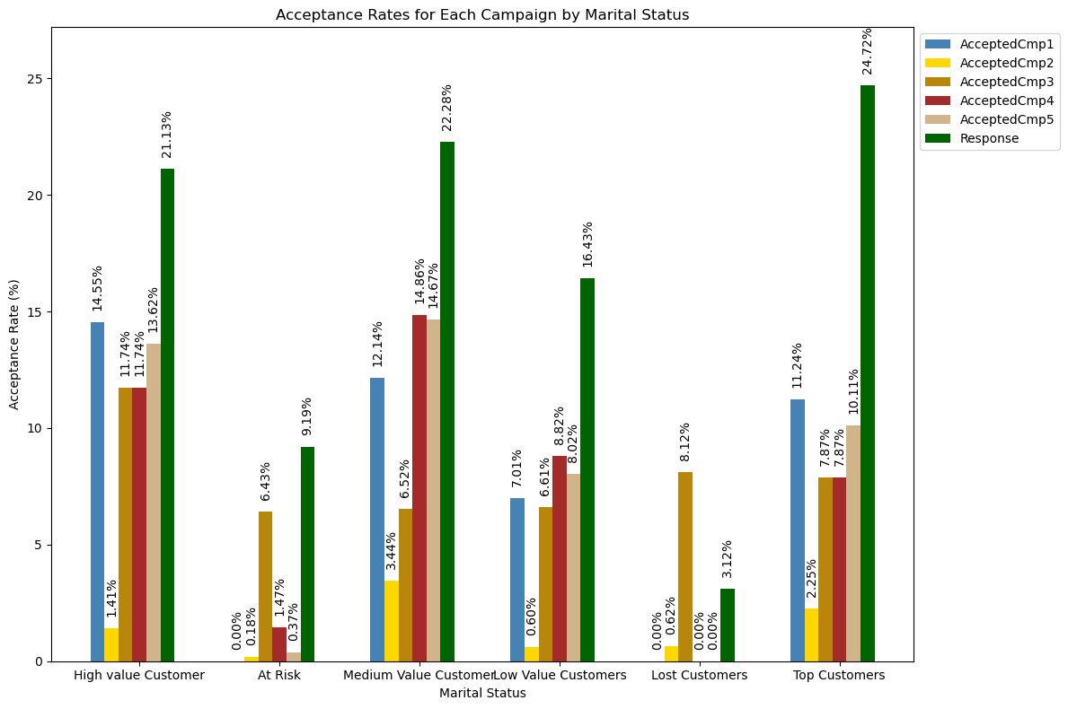
Assessing Campaign Performance

Slide 28
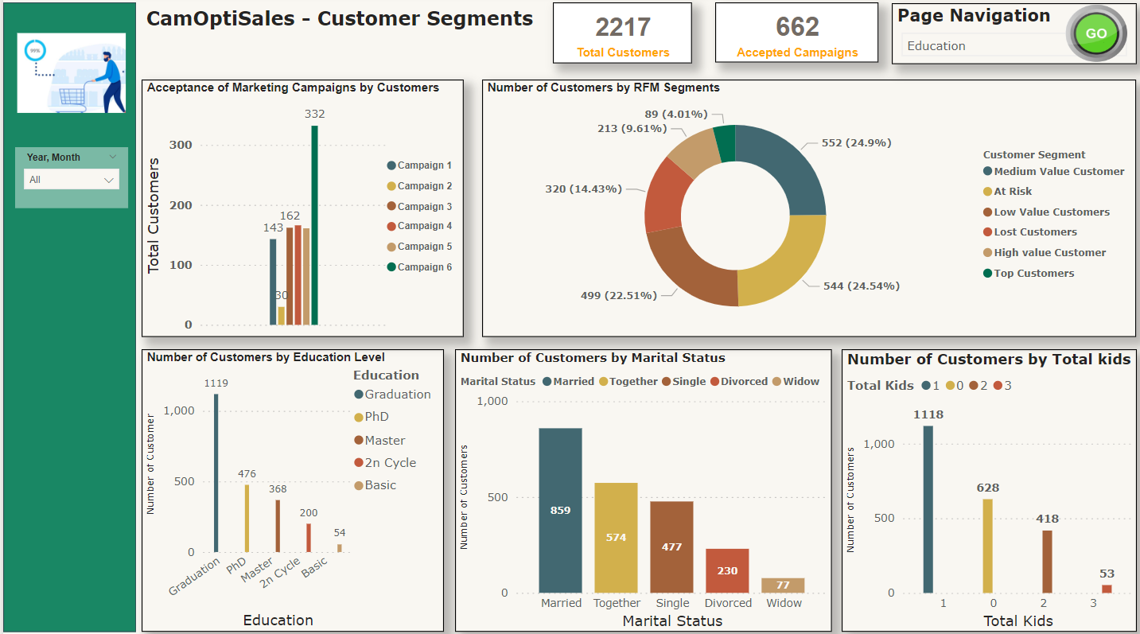
Moving to Power BI-Dashboards
Card
Page Navigation
Slicers
Pie-Chart and Donut Charts
Column Bar Chart
Clustered Column Chart

Slide 29


Microsoft Power BI

Slide 30

Relaunch the add-in
Microsoft Power BI
After you install the add-in, you can launch it by choosing the add-in button on the Insert tab
On the Insert tab
Insert
My Add-ins
Need more help?
Return to your internet browser or copy this link into your browser:
https://pages.store.office.com/addinsinstallpage.aspx?rs=en-US&assetid=WA200003233&isWac=True&ui=en-US&ad=US

Slide 31
THANK YOU!
ANY QUESTIONS?

